Slide 1
DATS 6103 Individual Project 3 Global Scientific Research Analysis: Scientific Articles Publication and Research Expenditure
Hao Ning
hning@gwmail.gwu.edu

Slide 2
Project Overview
Source of data
Data import and cleaning
Data visualization and analysis
Overview of Scientific Research Publication
Top Scientific Research Countries
Number of Publication Change of the Top Countries in Absolute and Percentage
Research Expenditure Analysis
Correlation between Publication and Research Expenditure
Most 'Productive' Countries
Summary

Slide 3
Source of Data
Source
World Bank
Scientific and technical journal articles
Research and development expenditure (% of GDP)
GDP (current USD)
Years studies from 2003 to 2016
Scientific articles dataset only contain data from 2003 to 2016

Slide 4
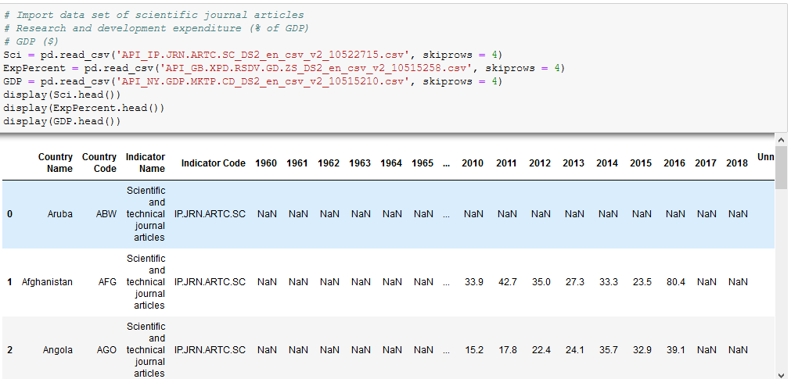
Data Import
Import packages:
Pandas, Numpy, pycountry, matplotlib.pyplot, plotly
Read CSV
Dataset have rows are “area” such as “East Asia”, “North America”
Use pycountry to compare the country ISO3 code and get all the countries

Slide 5

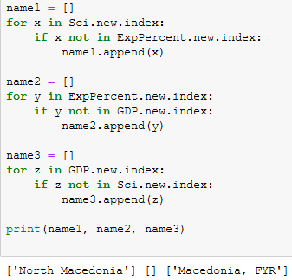
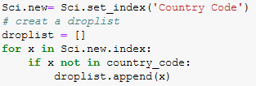
Data Cleaning
For loop to match country code
Create a droplist
Drop rows that are not countries
Reset index to country
For loop to match country index
Rename for consistency
.loc year 2003 to 2016, fillna(0), change data type to float
Calculate expenditure in USD
Expenditure (GDP %) * GDP

Slide 6
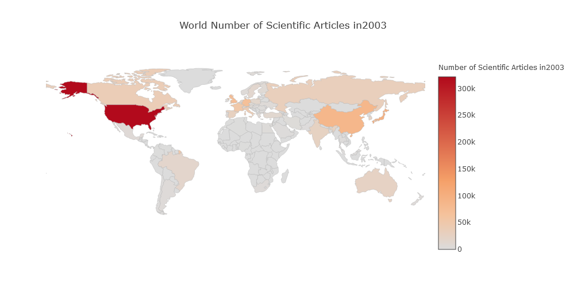
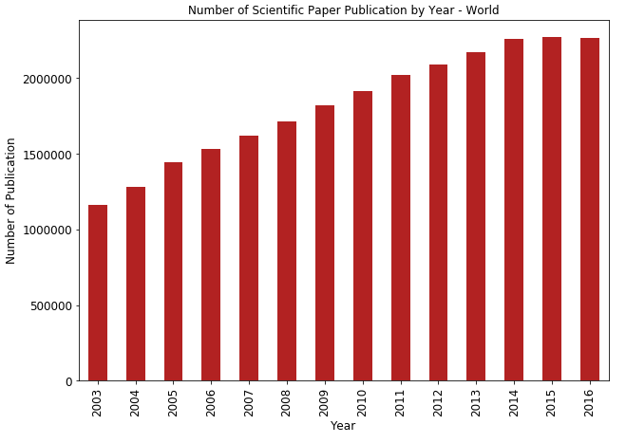
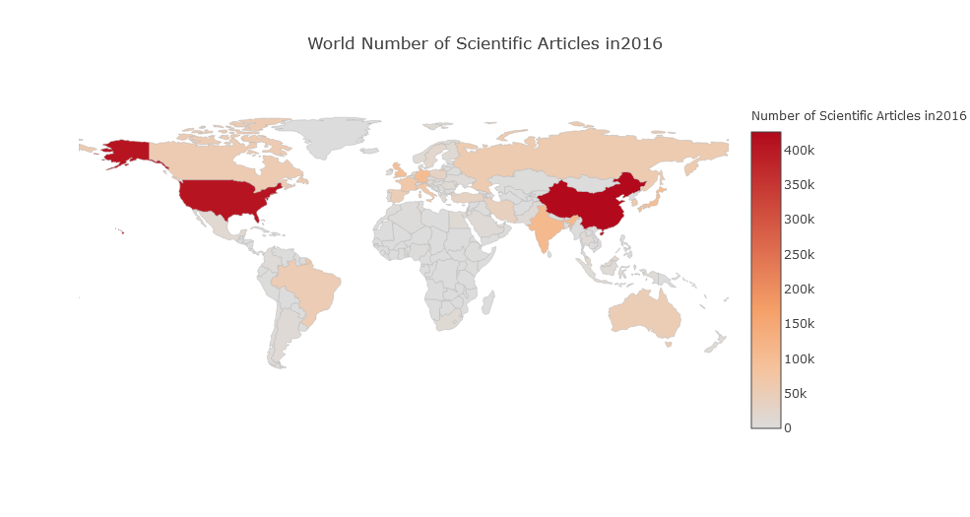
Overview Global Scientific Publication

Slide 7
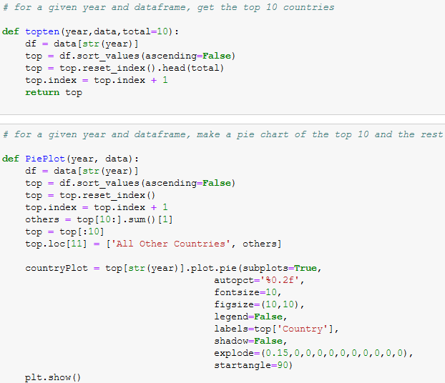
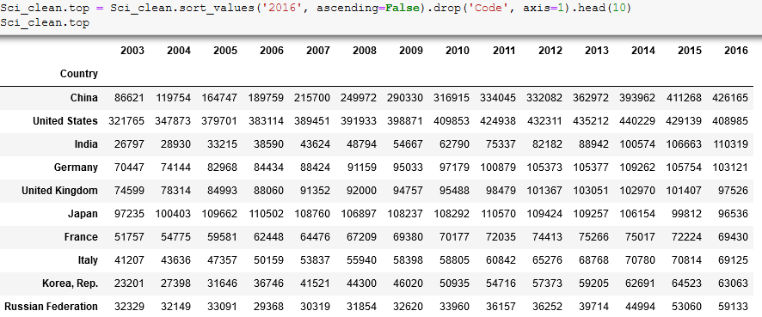
Top Publication Countries
Sort_Values by year 2016
Define functions (given year and data):
Get top 10 countries
Plot pie chart of top 10 countries and all other countries

Slide 8
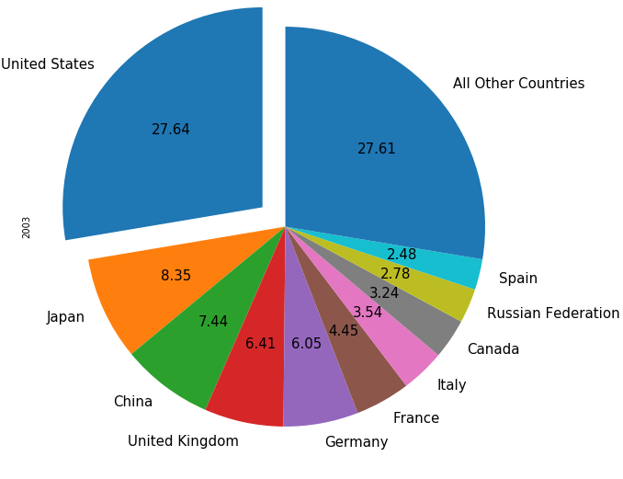
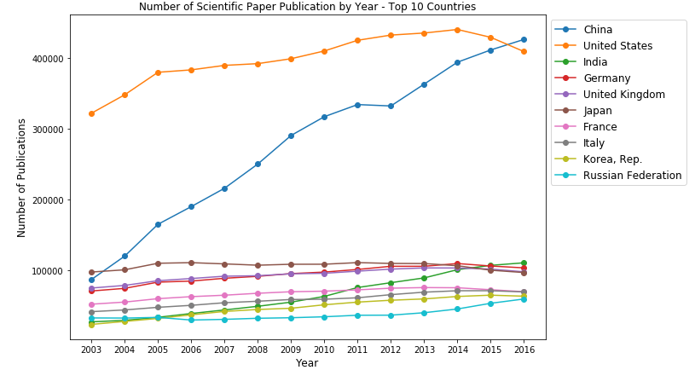
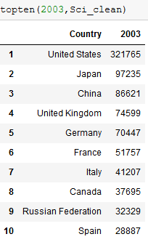
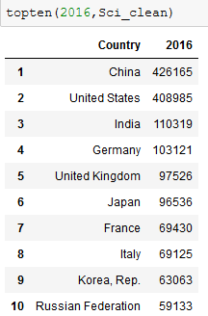
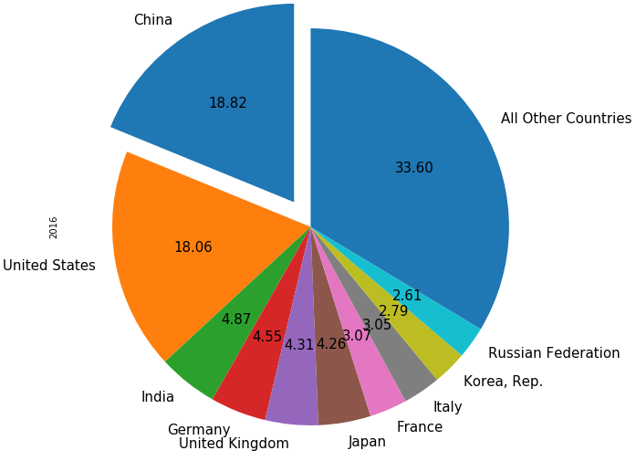
Top Publication Countries Plot

Slide 9
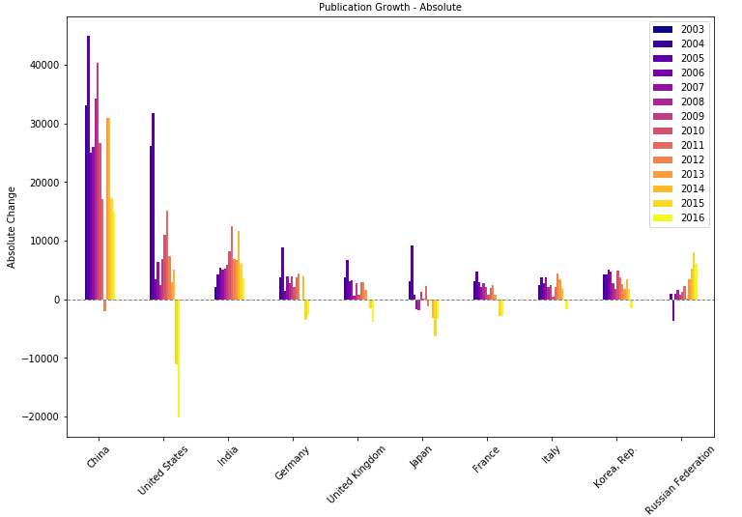
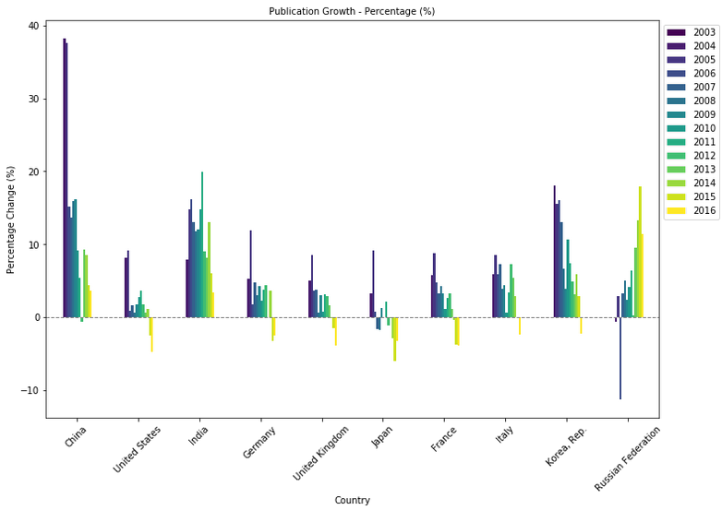
Change of Number of Publication
Use diff() function for absolute change
Use pct_change() function for % change

Slide 10
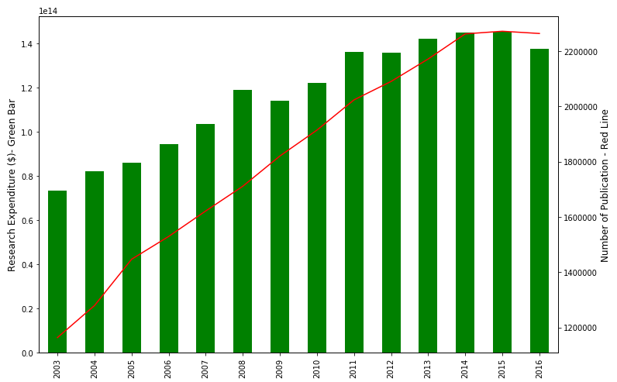
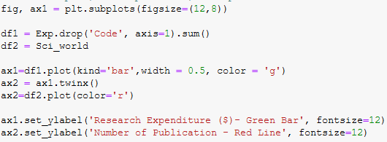
Research Expenditure Analysis
Overview of global total expenditure
Bar - line plot - using twinx()
Bar - Expenditure
Line - Publication

Slide 11
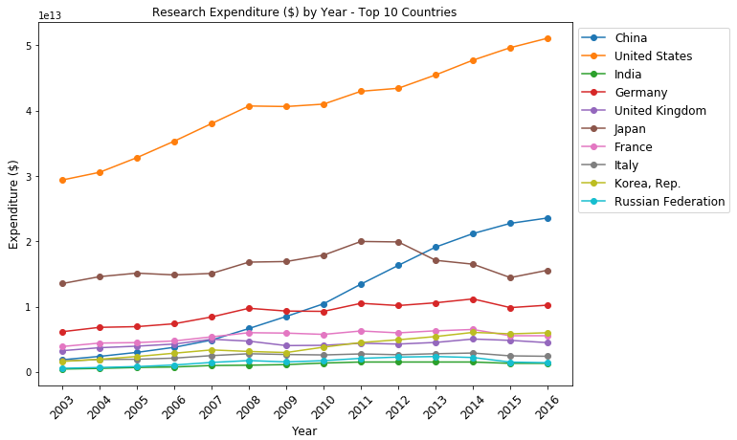
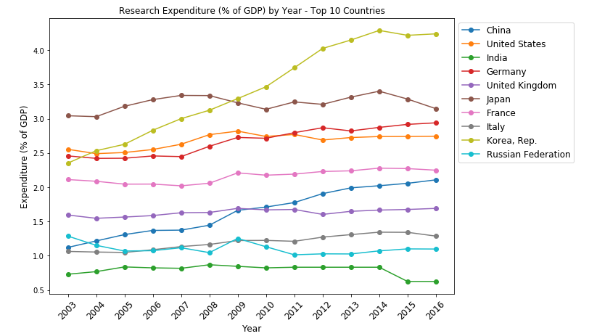
Expenditure of Top Countries
Note: India have some missing value, replaced by ffill() (previous value)

Slide 12
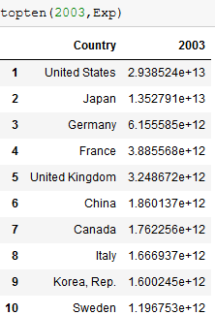
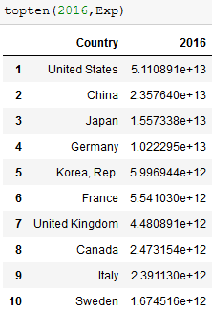
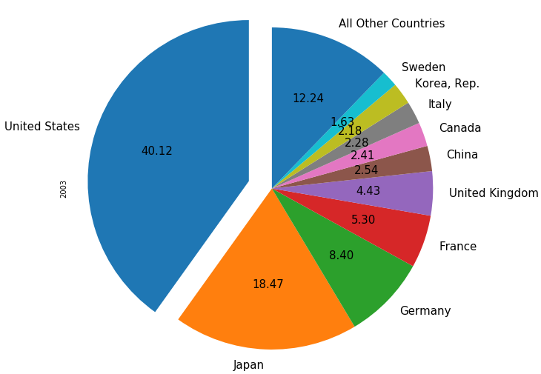
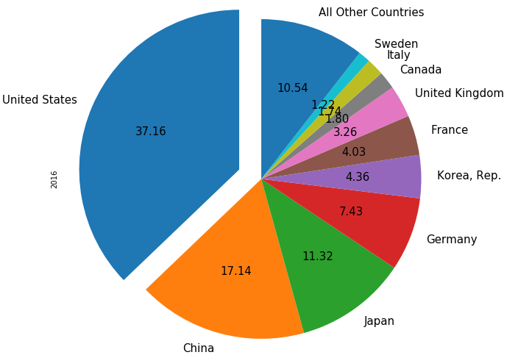
Research Expenditure - Detailed

Slide 13
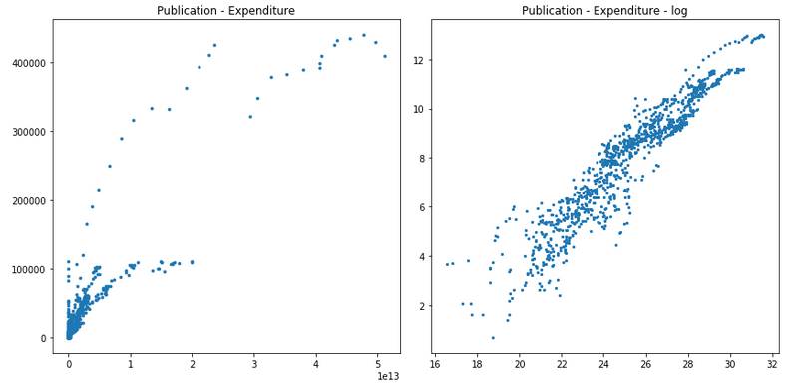
Correlation

Slide 14
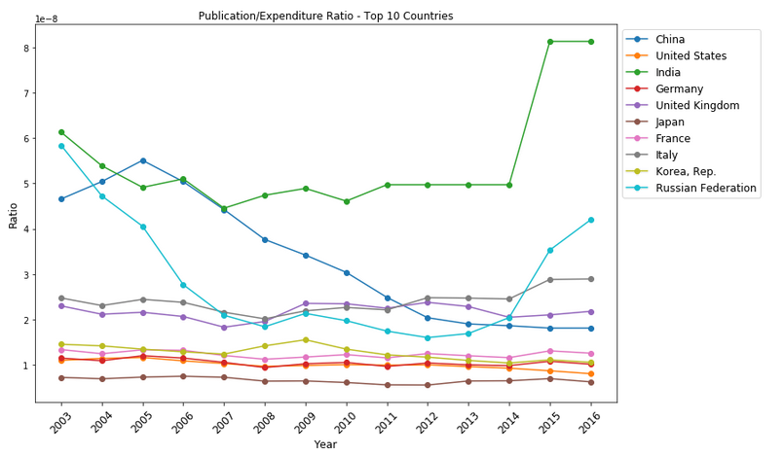
Most 'Productive' Countries
Calculate ratio - productivity
Ratio = Publication Number/Expenditure
India have some missing value, replaced by ffill() (previous value)
Productivity
India - high overall
Russia - U shape
China - decreased and stabled
Other - stable
Developed countries might have more citations rather than number of publication

Slide 15
Summary
Global Scientific Research Analysis from 2003 to 2016
Scientific articles publication number
Research Expenditure in absolute and GDP percentage
Key observation and conclusions
From 2003 to 2016, the number of global publication keep increasing then plateaued after 2014
USA was the only giant in publication in 2003, while in 2016, China climbed up (fastest growth) to top and these two countries became the flagships.
USA has an dominating expenditure in scientific research
Japan, USA and Germany are maintaining a high research expenditure % of GDP (2.5-3%).
Korea dramatically increased expenditure % ( >4% ) and became top10 publication countries.
An obvious positive correlation is observed for publication/expenditure, but indicating differences in 'productivity'
India, Russia and China are the most 'productive' countries

Slide 16
References
Jeff Tollefson. "China declared world’s largest producer of scientific articles", Nature, Volume 553, Issue 7689, pp. 390 (2018). DOI: 10.1038/d41586-018-00927-4
Lee-Roy Chetty. 2012. "The Role of Science and Technology in the Developing World in the 21st Century", URL: https://ieet.org/index.php/IEET2/more/chetty20121003
Karen E. White, Carol Robbins, Beethika Khan, and Christina Freyman. 2017. "Science and Engineering Publication Output Trends: 2014 Shows Rise of Developing Country Output while Developed Countries Dominate Highly Cited Publications", URL: https://www.nsf.gov/statistics/2018/nsf18300/

Slide 17
Thank you!

